Slide 1
ASP.NET Core MVC
Programming Advanced

Slide 2
Securing a Web API

Slide 3
Objectives
Explain what a Web API is
Setup a Web API
Use the Postman tool to create http requests
Understand Bearer token authentication
Setup Identity (with EF)
Setup Bearer token authentication
Using Identity in an Authentication controller
Authorize http requests
Know about other authentication methods

Slide 4
Prerequisites
Up-to-date version of Visual Studio 2022 Community: https://www.visualstudio.com/downloads
.NET Core 3.1 SDK: https://dotnet.microsoft.com/download
Postman: https://www.getpostman.com

Slide 5
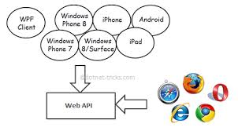
What is a Web API?
Web application that exposes data services over HTTP. Preferably in a RESTful manner.
Notes:
WebAPI
Today, a web-based application is not enough to reach it's customers.
People are using phones, mobile, tablets etc. devices in its daily life.
These devices also have a lot of apps for making the life easy. Actually, we are moving from the web towards apps world.
So, if you like to expose your service data to the browsers and as well as all these modern devices apps in fast and simple way, you should have an API which is compatible with browsers and all these devices.
For example Twitter, Facebook and Google APIs for web applications and phone apps.
ASP.NET Core is a framework that makes it easy to build HTTP services that reach a broad range of clients, including browsers and mobile devices.
ASP.NET Core is an ideal platform for building RESTful applications on the .NET Framework.
A RESTful API is an application program interface (API) that uses HTTP requests to GET, PUT, POST and DELETE data (REST = Representational State Transfer).
HTTP APIs become increasingly important with the proliferation of devices that we use today.
Most mobile devices, like phones and tablets, run apps that use data retrieved from the Web over HTTP.
Desktop applications are also moving in this direction with more and more online content and synching.
Likewise, many web applications rely on rich client functionality to create and manipulate the browser user interface, using AJAX http requests rather than server-generated HTML data to load up the user interface with data.
Results returned from these remote HTTP services are data rather than HTML markup.
This data tends in the JSON (JavaScript Object Notation) format (other formats are also possible).
ASP.NET Core provides an easy way to build the backend code to handle these remote API calls using a flexible framework that is based very specifically around the semantics of the HTTP protocol.

Slide 6
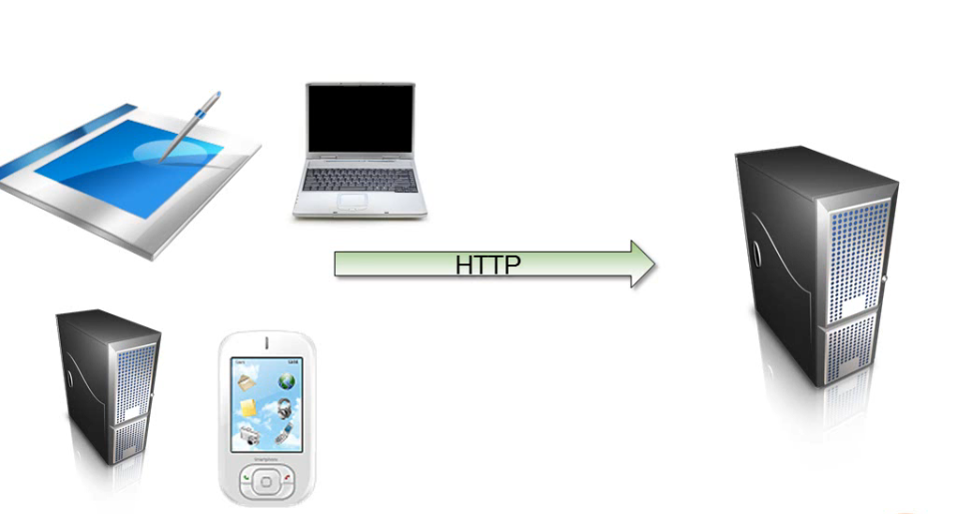
HTTP Web Services
Allow 2 ‘computers’ to communicate and exchange data

Slide 7
HTTP Web Services
HTTP messages
can be cached
can travel through a firewall
can be processed by processors of mobile devices
can be encrypted
are lightweight
Nearly every programming environment in the world offers some capability to send and receive HTTP messages

Slide 8
JSON
JavaScript Object Notation
lightweight data-interchange format
easy for humans to read and write
easy for machines to parse and generate
Example:
[
{
"Name": "JSON",
"Type": "Data exchange format",
"IsProgrammingLanguage": false,
"See also": [ "XML", "ASN.1" ]
},
{
"Name": "JavaScript",
"Type": "Programmeertaal",
"IsProgrammingLanguage": true,
"Year": 1995
}
]
Notes:
JSON
JSON (JavaScript Object Notation) is a lightweight data-interchange format.
It is easy for humans to read and write.
It is easy for machines to parse and generate.
It is based on a subset of the JavaScript Programming Language,Standard ECMA-262 3rd Edition - December 1999
It is a text format that is completely language independent but uses conventions that are familiar to programmers of the C-family of languages, including C, C++, C#, Java, JavaScript, Perl, Python, and many others.
These properties make JSON an ideal data-interchange language.
JSON is built on two structures:
A collection of name/value pairs. In various languages, this is realized as an object, record, struct, dictionary, hash table, keyed list, or associative array.
An ordered list of values. In most languages, this is realized as an array, vector, list, or sequence.
These are universal data structures. Virtually all modern programming languages support them in one form or another.
It makes sense that a data format that is interchangeable with programming languages also be based on these structures.
The website http://www.json.org shows the different forms JSON can take.

Slide 9
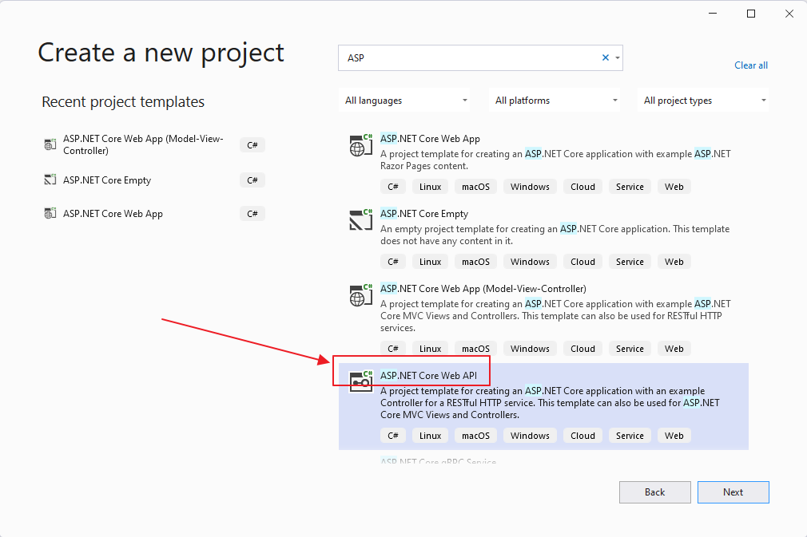
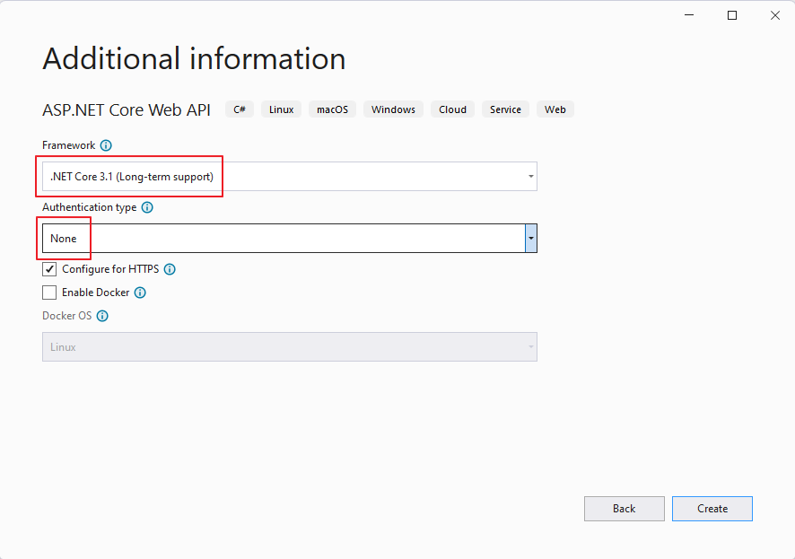
Create Web API application
Create a new ASP.NET Core web application, using the API template
Project name: “SecureDemo.Api”
Solution name: “SecureWebApiDemo”

Slide 10
Bearer token authentication
Securing a Web API

Slide 11
Intro
Authentication = how we establish the identity of a user
Authorization = how we make sure a given identity is allowed to perform some specific action in the application
2 options:
Use ASP.NET Identity framework to manage users locally in your application (our focus in this module)
Trust third parties (Azure AD, Google, Facebook, …) to provide a user’s identity (OpenID Connect)
Notes:
In this module we will focus on managing users with the Identity framework and securing a Web API with Bearer token authentication.
The Web API that we will build in this module will (also) be an authentication server that manages users and can hand out access tokens that clients can use to authenticate themselves.
In the Pluralsight course “ASP.NET Core Fundamentals” the module about authentication focuses on the second option (OpenID Connect).
For this reason the module about authentication in de Pluralsight course is optional.

Slide 12
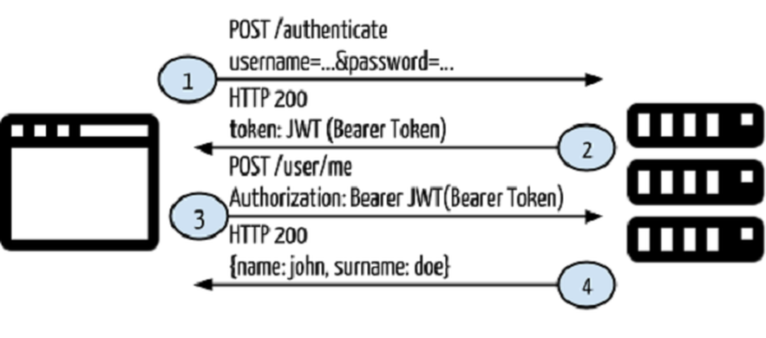
Flow
Client sends a http post request containing user credentials.
Web API responds with an access token (= encrypted string)
Client sends a http request to a secured part of the API (with the token in the ‘Authorization’ header of the request).
If the user (who’s info can be found in the token) is authorized, the request is processed. Otherwise a 401 (Unauthorized) response is sent back.
Notes:
To access protected resources, the client asks the authentication server (the Web API in our case) for an access token.
When doing this the client provides some form of credentials (e.g. username and password).
If the credentials are valid the server returns an access token. The access token is an encrypted string that contains information about the user (claims).
Whenever the user wants to access a protected route or resource, he should send the access token, typically in the Authorization header using the Bearer schema.
The header in the http request should look like this:
Authorization: Bearer <token>

Slide 13
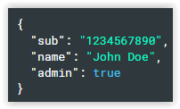
JWT Bearer Token
JWT = JSON web token
Defines a compact and self-contained way for securely transmitting information between parties as a JSON object.
Is digitally signed so it can be verified and trusted.
Contains claims (Claims are statements about the user)
Our Bearer tokens will be encrypted JWT tokens
Anyone can use the token. In other words, a client doesn’t need a cryptographic key or other secret to use a bearer token. For that reason, bearer tokens should only be used over HTTPS, and should have relatively short expiration times.
Metaphor: At the reception of a building you get an access card (token). The access card contains information (claims) that determines which rooms in the building you can access.
Notes:
Since our Web API will be the authentication server we need a way to create access tokens that contain information about the user.
We will use the JSON web token (JWT) format.
To generate a token we will create a JSON string that contains information about the user (e.g. name, user identitfier, email, roles, …).
The JSON string will also contain a digital signature so that it can be verified.
The tokens that our Web API will hand out are encrypted strings of these JSON strings.
Once someone obtains a token it can be used for authentication. This person does not need a cryptographic key or other secret to use the token. He just has to add the token in the Authorization header of the http request.
For that reason, bearer tokens should only be used over SSL (so no man in the middle can obtain the token from the http request) and should have a relatively short expiration times (typically a few minutes).

Slide 14
Claims based authorization
When a user (an identity) is registered it may be assigned one or more claims issued by a trusted party. A claim is a name value pair that represents what the subject is (not what the subject can do).
Example: a driver’s license:
Issued by driving license authority
Claims: name, first name, date of birth
Claims based authorization checks the value of a claim and allows access to a resource based upon that value.
For example if you want access to a night club the door security officer would evaluate the value of your date of birth claim and whether they trust the issuer (the driving license authority) before granting you access.
Notes:
In our application the Web API itself will be the trusted party that assigns claims to new users (during registration).
When we authorize (is not authenticate) a user we check the claims in the token. E.g. the ‘role’ (student, lector) of the user can be a claim assigned by the trusted party (our own application). Based on de value of this role / claim we can grant or deny access to a resource (e.g. exam results).

Slide 15
Setup Identity
Securing a Web API
Notes:
If we want to be an authorization server, we need a way to manage and store the users.
We will use the ASP.NET Core Identity framework to achieve this.

Slide 16
Identity
ASP.NET Core Identity is a membership system that adds login functionality to ASP.NET Core apps.
Identity can be configured using a SQL Server database to store user names, passwords, and profile data. Identity uses Entity Framework (EF) to access its data store. So alternatively, another persistent store can be used, for example, Azure Table Storage.
With Identity it is also possible to use external login providers like Facebook, Google, Microsoft and Twitter.
We will use Identity to store user information in a database and let the Web Api function as the (trusted) authorization server.
Notes:
More detailed documentation:
https://docs.microsoft.com/en-us/aspnet/core/security/authentication/identity

Slide 17
Domain layer
Add a class library named “SecureDemo.Domain”.
Target Framework: .NET Standard 2.1
Add the NuGet package “Microsoft.AspNetCore.Identity.EntityFrameworkCore” to the domain project
Attention: take the latest 3.1 version (not the 5.1 version)
Needed to be able to inherit from the IdentityUser and IdentityRole entities
Notes:
Add data layer

Slide 18
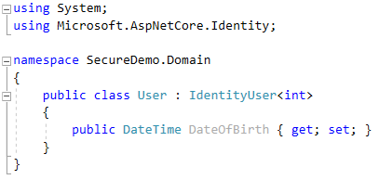
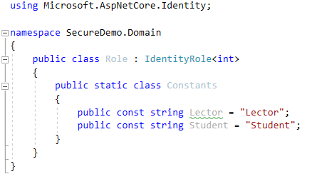
Domain layer
Add a “User” class that inherits from “IdentityUser”
Add a “Role” class that inherits from “IdentityRole”
Notes:
The generic <int> means that the primary key of a User/Role will be an integer.
Go to the definition (right click, F12) of the IdentityUser class and the IdentityRole class to see its properties.
For users we also want to persist the DateOfBirth, so an extra property is added.
In the Role class we add a “Constants” class that will be useful later on.

Slide 19
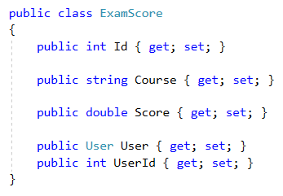
Domain layer
Add a “ExamScore” class that holds the score on an exam for a certain user.

Slide 20
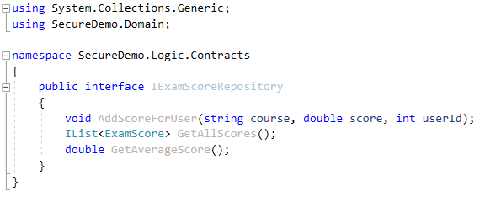
Logic layer
Add a class library named “SecureDemo.Logic”.
Target Framework: .NET Standard 2.1
Add Contracts folder
Add IExamScoreRepository interface
Notes:
Add data layer

Slide 21
Infrastructure layer
Add a class library named “SecureDemo.Infrastructure”.
Target Framework: .NET Standard 2.1
Also add the NuGet package “Microsoft.AspNetCore.Identity.EntityFrameworkCore” to the infrastructure layer.
Add NuGet package Microsoft.EntityFrameworkCore.SqlServer (latest 3.1 version)
Notes:
Add data layer

Slide 22

Infrastructure layer
Add a “AssemblyInfo.cs” file that makes the internal classes visible to the API layer

Slide 23
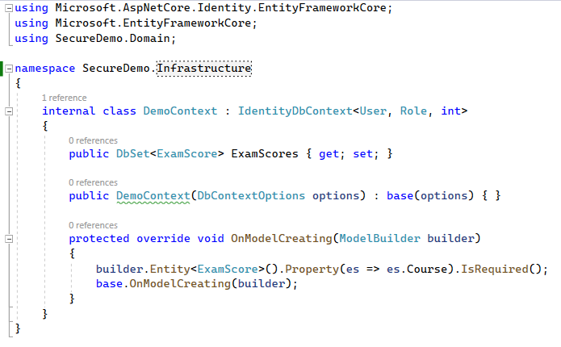
Infrastructure layer
Add a “DemoContext” class that will be used by EF to determine the data model.
Inherit form IdentityDbContext
Notes:
The generic <User, Role, int> means that Identity should use the User class and the Role class as user and role entities. Int is the type of the primary key properties.
Go to the definition (right click, F12) of the IdentityDbContext class to see the DbSet properties that are already defined.
Define the constructor so that it expects an options parameter that can be passed to the base constructor. This will make it possible to configure the context in the StartUp class.
Make sure the Course property of ExamScore is not nullable in the database.

Slide 24
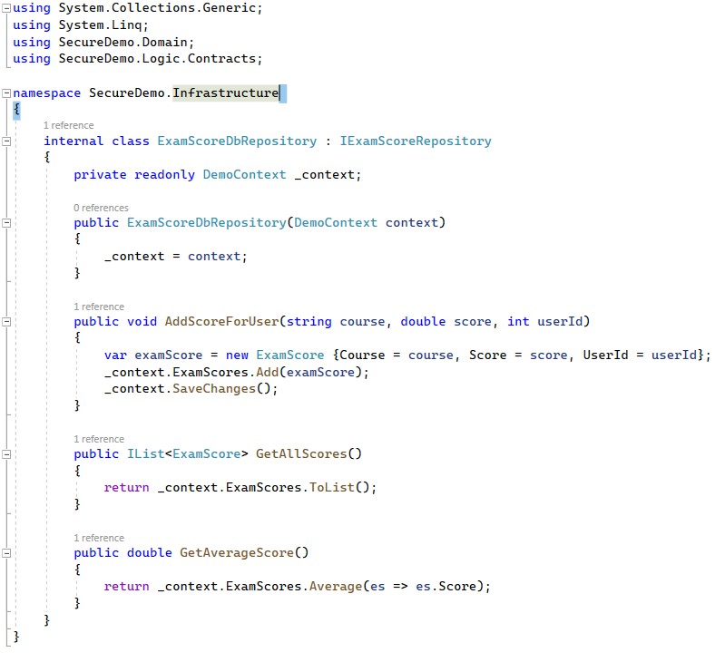
Infrastructure layer
Add a “ExamScoreDbRepository” class

Slide 25
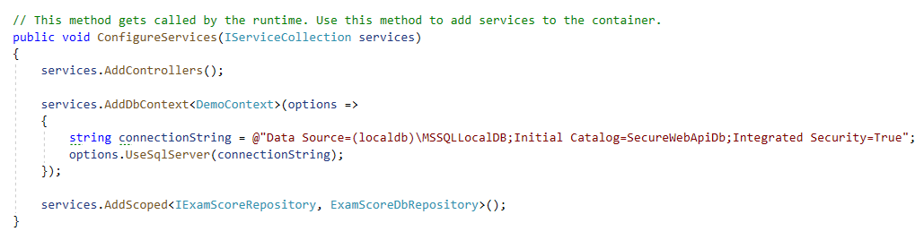
Api layer
Also add NuGet package Microsoft.EntityFrameworkCore.SqlServer (latest 3.1 version)
Add NuGet package Microsoft.EntityFrameworkCore.Tools (latest 3.1 version)
Setup DbContext in StartUp class of API project
Tell EF that the database is a Microsoft SQL Server and provide the connectionstring
Add IExamScoreRepository service

Slide 26
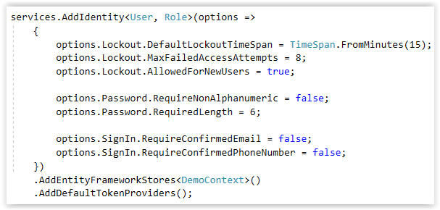
Api layer
Add Identity services to the dependency injection container
Set options (e.g. Does a new user has to confirm his email address? What is the minimum length of a password? ….)
Link the database (AddEntityFrameworkStores<DemoContext>())
Use default providers for generating tokens uses when changing password, confirming email, …. (AddDefaultTokenProviders())

Slide 27
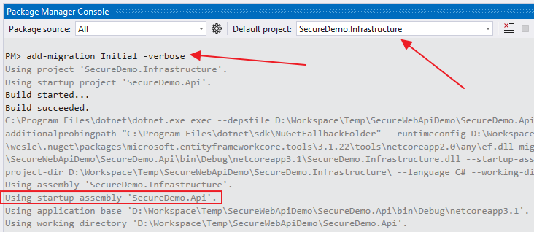
Migration
Add an initial migration

Slide 28
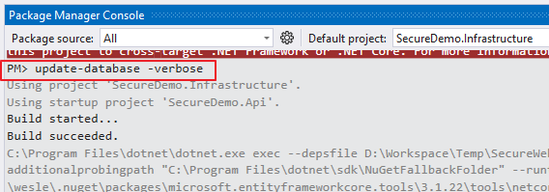
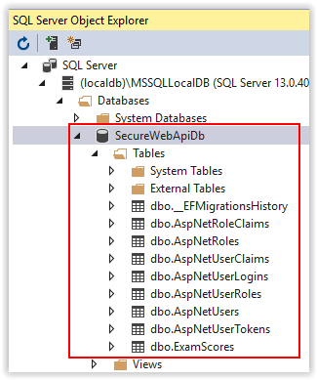
Create database
Create the database
Notes:
The database contains a table for the ExamScore entity, but also a bunch of other tables.
These other tables are used to store:
User accounts (dbo.AspNetUsers)
Roles (dbo.AspNetRoles, dbo.AspNetUserRoles)
Claims of the users (dbo.AspNetUserClaims)
Claims of the roles (dbo.AspNetRoleClaims)
Linked external accounts (e.g. Google account) of users (dbo.AspNetUserLogins)
Tokens received from the external parties (e.g. Google) (dbo.AspNetUserTokens)
Don’t like the names of the tables? -> Use Fluent Api to tell EF to use other names. E.g.: builder.Entity<User>().ToTable("Users");

Slide 29
Create an Authentication Controller
Securing a Web API

Slide 30
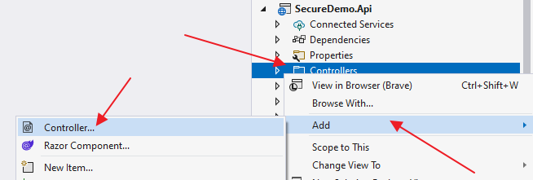
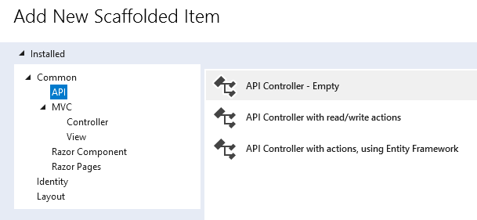
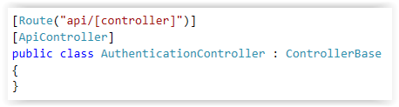
AuthenticationController
Add an empty API Controller named “AuthenticationController” to the API project.
Notes:
Decorates the class with the [ApiController] attribute. This attribute indicates that the controller responds to web API requests and enables some features like automatically responding with a BadRequest if a model validation error occurs.
For information about specific behaviors that the attribute enables, see https://docs.microsoft.com/en-us/aspnet/core/web-api/index?#apicontroller-attribute.
The controller inherits from ControllerBase which is a base class for MVC controllers that don’t need View support.

Slide 31
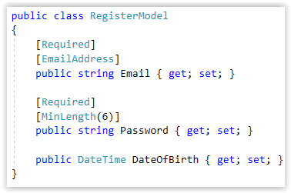
Registration
Create a RegisterModel class (in a Models folder) that will contain the posted data when a users fills in a registration form
Notes:
When a client sends a http request to register a new user, the body of the request should contain the following information:
Email of the user
Password the user chose
DateOfBirth of the user
We use data annotation attributes to help MVC determine if the values are valid.

Slide 32
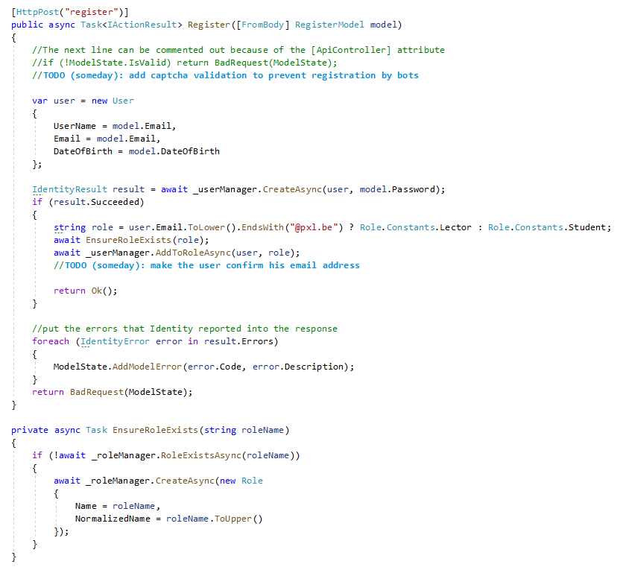
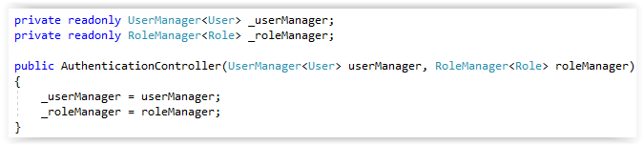
Registration
Add a registration action
Notes:
Now we can add an action to our controller that is executed when a client sends a http post request to “api/authentication/register”.
The HttpPost attribute can also define a route template, so the Route attribute can be omitted.
The [FromBody] attribute indicates that MVC should look for the data for the parameter in the body of the http request.
First we check if the posted data is valid (ModelState.IsValid). MVC checks the data that is passed into the action method (the parameter, the modelstate) using the data annotation attributes in the RegisterModel class.
If the ModelState is not valid, we tell the client that he has sent us a bad http request by returning a 400 response with the error messages in the body.
Normally we should add some captcha validation in the process because anyone can send http requests to the “api/authentication/register”. So automated bots could try to register thousands of users.
But for simplicity reasons we skip this feature.
Next we use the injected UserManager from the Identity framework to create a user (not that we use the email adres as username). The UserManager, does all the hard work. We only need to check the result of the operation.
If the user is successfully created we use the injected RoleManager of the Identity framework to create the right role if it does not exist yet.
Then we link the user with the right role.
If everything succeeds we return an empty OK (200) response.
If something went wrong (e.g. password is not strong enough) we add the errors to the modelstate and return a bad request response (400) with the errors in the body.

Slide 33
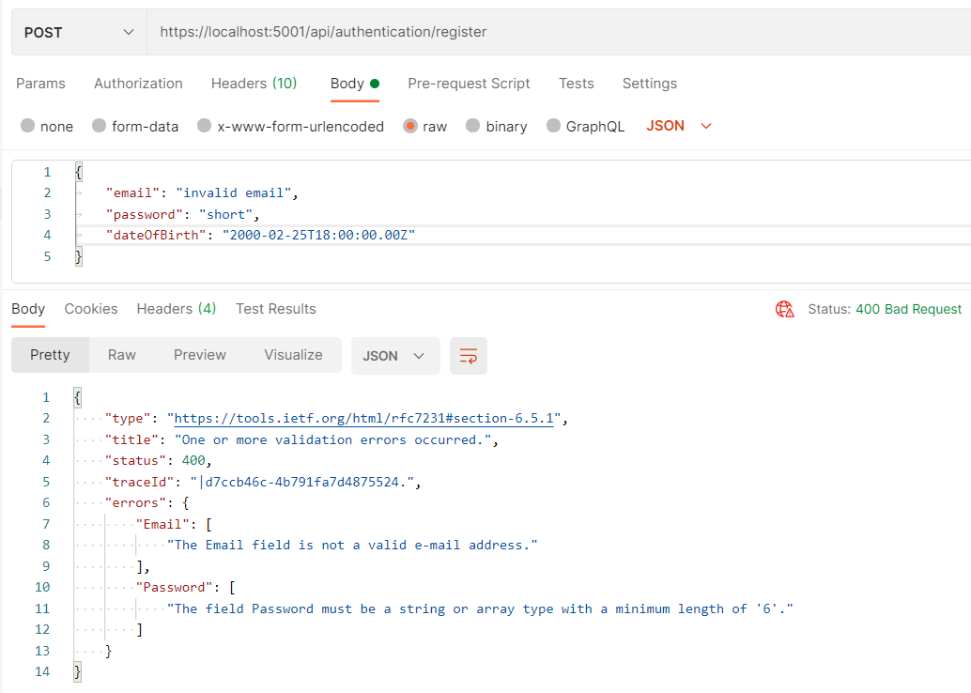
Registration
Invalid registration request

Slide 34
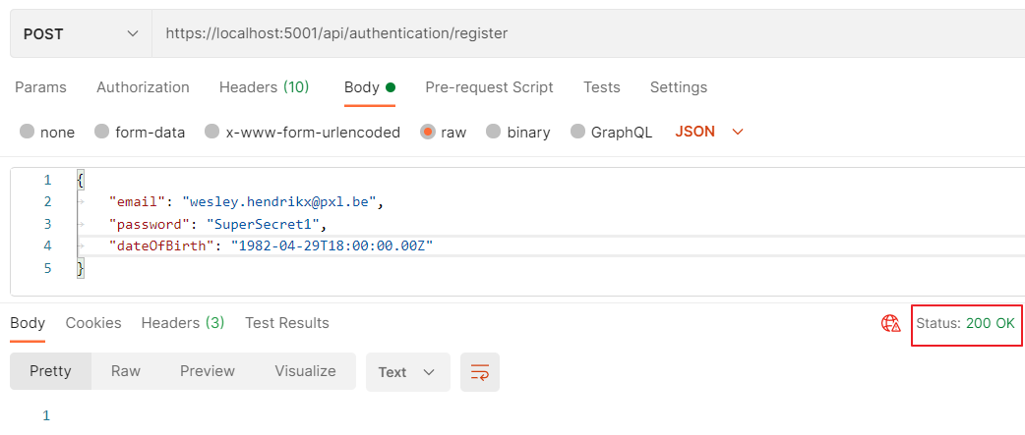
Registration
Valid registration request

Slide 35
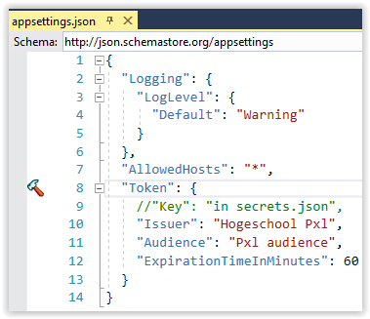
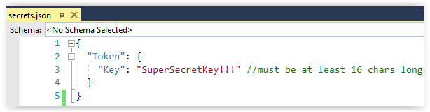
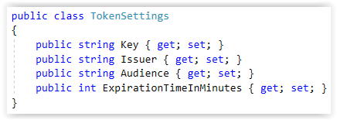
Request token
Add CreateToken action -> first add some settings for token generation
Notes:
Next we want to expose an action that accepts user credentials and returns a bearer token if the credentials are valid.
To do this we first need to add some settings that will be used for creating JWT tokens:
Key: symmetric secret key used to sign, encrypt and decrypt the JWT tokens. This should not be stored in ‘appsettings.json’ (which is probably visible in source control (git)). Right click on the project and select “Manage User Secrets” from the context menu. This will open a local file ‘secrets.json’ that is merged with ‘appsettings.json’. Only you can use this file. More info: https://docs.microsoft.com/en-us/aspnet/core/security/app-secrets
Issuer: name of the issuer of the token. Only tokens from this issuer will be accepted by our application.
Audience: to who are the tokens issued? Only tokens from the same audience will be accepted by our application.
ExpirationTimeInMinutes: how long will a token remain valid?
Next we add a TokenSettings class (in a Settings folder) that has matching properties.
By executing ‘services.Configure<TokenSettings>(Configuration.GetSection("Token"));’ in StartUp.cs, we can inject IOptions<TokenSettings> into our controllers. The dependency injection system will inject an instance of the IOptions interface containing a filled instance of the TokenSettings class.

Slide 36
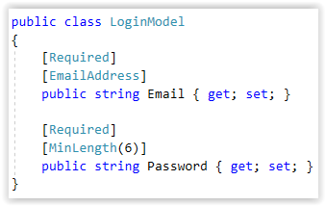
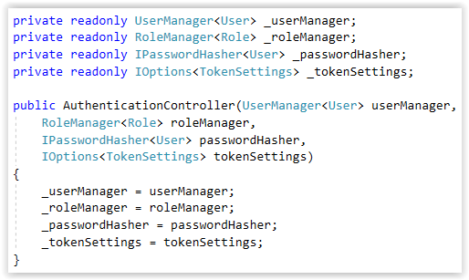
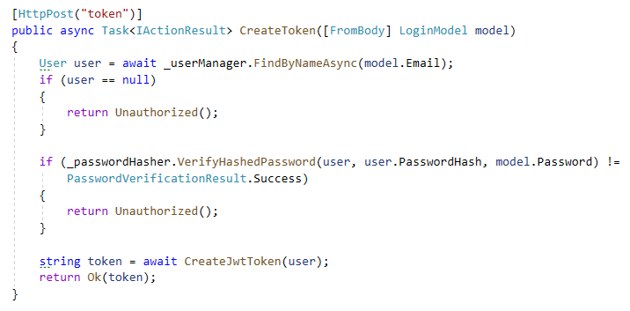
Request token
Add CreateToken action
Notes:
Now we can add the CreateToken action method.
Via the constructor we add an IPasswordHasher (from the Identity framework) and our token settings.
A user can request a token by sending an http post request to “api/authentication/token”. The LoginModel parameter contains the credentials of the user.
If the user can be found an the hashes of the passwords match we create and return the token (creation of the token is explained in the next slide).
Otherwise we send a 401 Unauthorized response to the client.

Slide 37
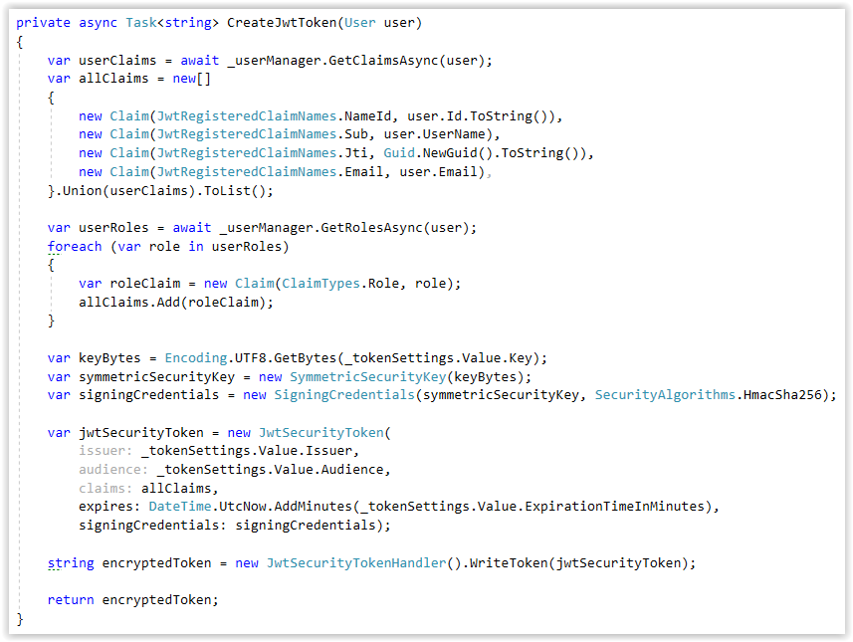
Request token
Add CreateToken action -> Token creation
Notes:
To create the token we first create a collection of claims:
NameId: the unique identifier (id) of the user in the database
Sub (subject): the username
Jti (JWT Id): unique identifier for the jwt token
Email: email address of the user
User claims: other claims of the user that are stored in the database
Role claims: for each role the user has, we add a claim
Next we create an encryption key using the ‘Key’ setting (from secrets.json).
Then we create the token with issuer, audience, claims, expiration date, and signature info).
The writeToken method encrypts the JWT token.
PS: it would be better to move the token creation code to a service. E.g. ITokenCreator.

Slide 38
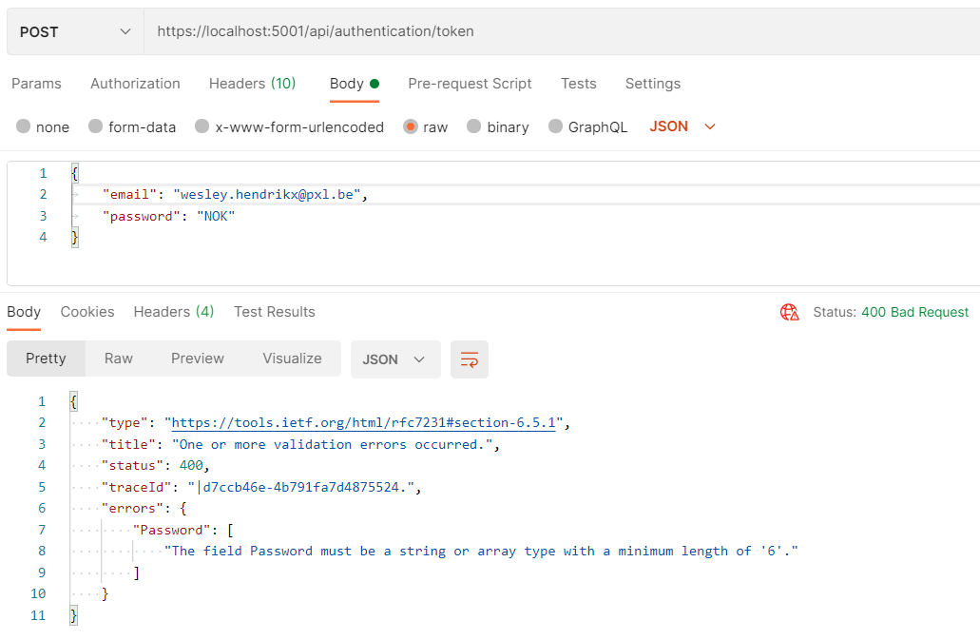
Request token
Bad request

Slide 39
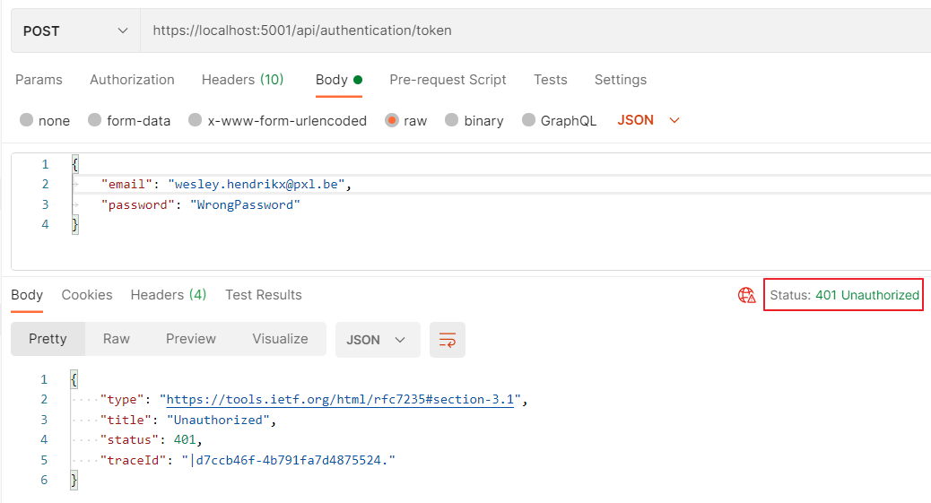
Request token
Wrong password

Slide 40
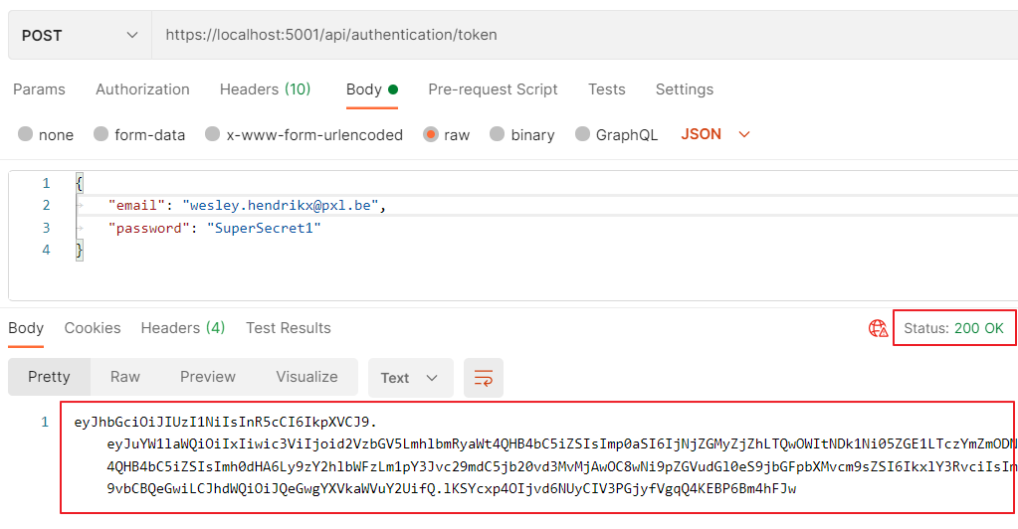
Request token
Valid token request

Slide 41
What is missing?
Confirm email mechanism after registration
Forgot password mechanism
Captcha validation for registration, forgot password
=> Identity provides functionalities to implement this… (out of scope for this course)

Slide 42
SetUP Authentication & Authorization
Securing a Web API

Slide 43
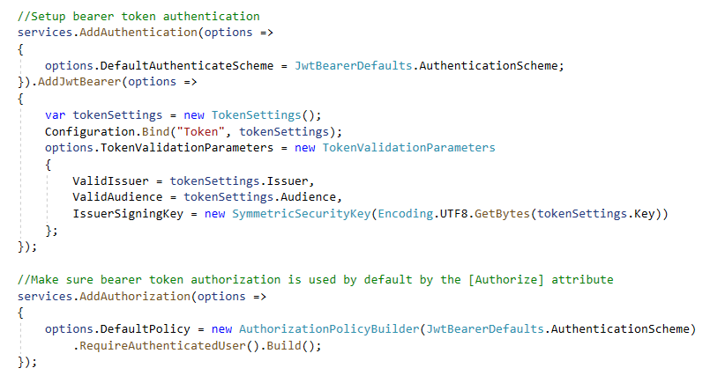
Add services
StartUp.cs -> add authentication
Add NuGet package Microsoft.AspNetCore.Authentication.JwtBearer (latest 3.1 version)
Notes:
Next to an authorization server our web API will also offer services (controller actions) that a client can call to access protected resources.
We will pretend that the ValuesController offers such services. So we need to add protection by authenticating and authorizing clients that try to use the action methods of the ValuesController.
The first thing to configure is the DefaultAuthenticateScheme.
An authentication scheme in ASP. NET Core is basically a friendly name for ‘how do we authenticate users’. Are we using cookies? Are we using tokens? Are we using some other approach?
By default, what we will actually be using in this ASP. NET Core application is the ‘Bearer’ scheme which causes bearer tokens in the Authorization header of the http request to be used.
Next we add some services that are needed to do JwtBearer authentication.
In the options we need to specify some stuff that will be used to validate the tokens that the application will receive.
First we need our token settings.
You might remember we injected a service that implements IConfiguration into the constructor of our Startup class, and we saved that off into a private field.
So we can now access this configuration service and tell it to do a Bind.
What Bind allows me to do is specify a section of my configuration by name, so let's say “Token”, and Bind will take the values that are inside and try to match them up with properties on a C# object, so much like model binding with the MVC framework.
Now we can provide the valid issuer and the valid audience. Tokens from other issuers or for another audience are now rejected.
We also need to provide the symmetric key that the application can use to decrypt the tokens that are coming in (IssuerSigningKey).
The last part makes sure that the “Bearer” authentication scheme is use by default when the application does authorization (e.g. by using the [Authorize] attribute which is discussed in the next slides).

Slide 44
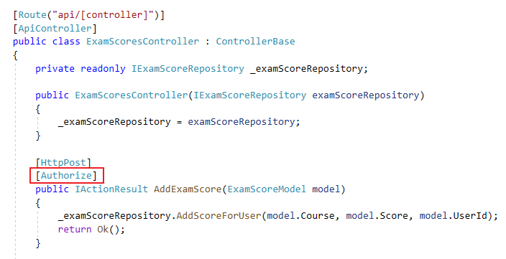
Authentication
Add ExamScoresController
Add “AddExamScore” action with “Authorize” attribute
Notes:
To protected a resource (action method) you can add the [Authorize] attribute the action method.
Now only authenticated users can execute the action method. Other requests get a 401 (Unauthorized) response).

Slide 45
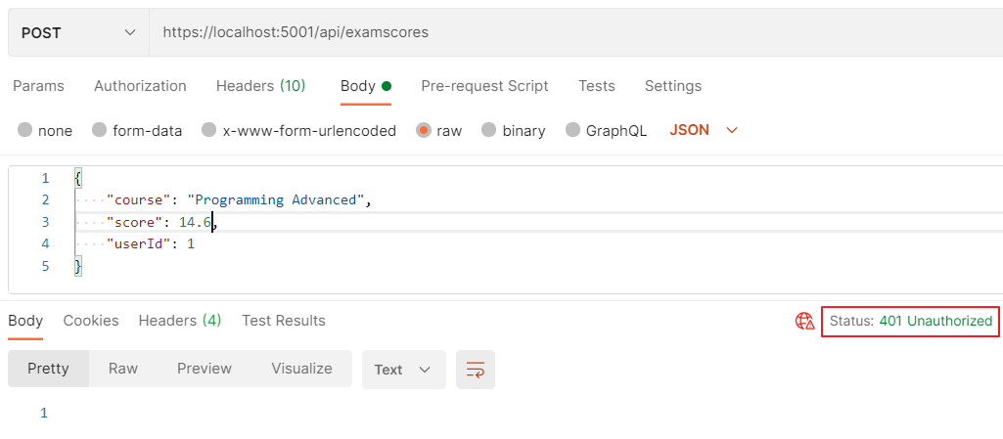
Post exam score
Post exam score unauthorized

Slide 46
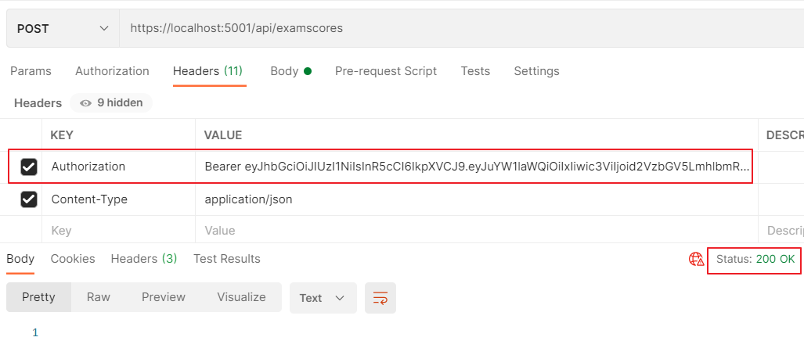
Post exam score
Post exam score with valid bearer token

Slide 47
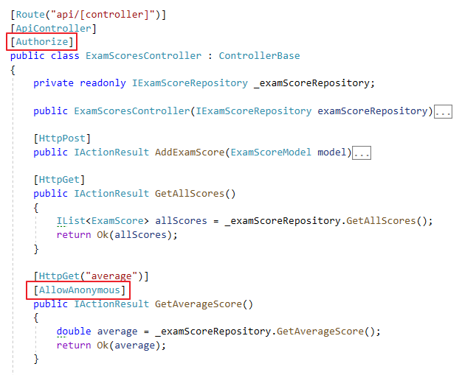
Authentication
Add actions: “GetAllScores”, “GetAverageScore”
Authorize all action by moving the [Authorize] attribute to the controller level
Exceptions can be made with the [AllowAnonymous] attribute
Notes:
If you want to protect all the action methods of a controller, you can also add the [Authorize] attribute above the class name.
With the [AllowAnonymous] attribute you can make an exception and allow an action to be accessed while not authenticated.

Slide 48
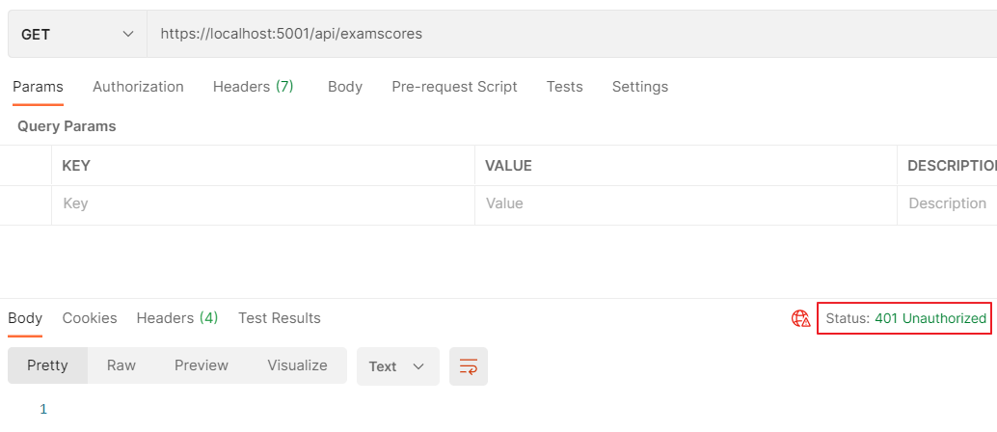
Get all scores
Get all scores anonymous

Slide 49
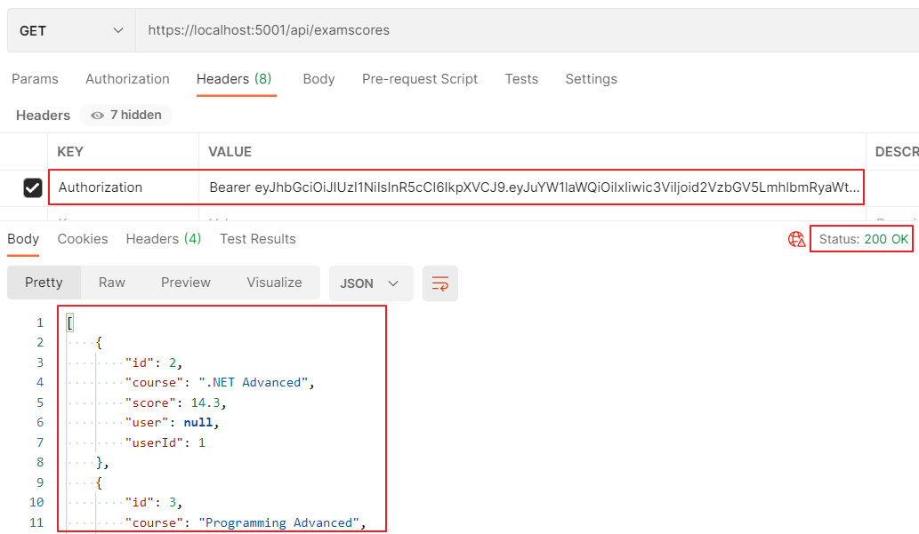
Get all scores
Get all scores with valid bearer token

Slide 50
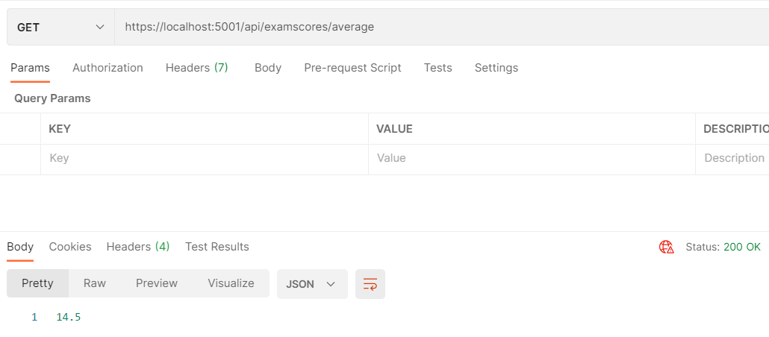
Get average score
Get average score anonymous

Slide 51
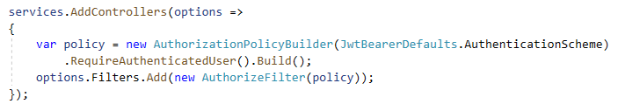
Authentication
Global filter to authenticate all incoming requests
There are different kinds of filters you can add to the pipeline. More info: https://docs.microsoft.com/en-us/aspnet/core/mvc/controllers/filters?view=aspnetcore-3.1
Notes:
If you want to protect all resources (action methods) with authentication, you can also add a global filter.
To do this you should add a filter when configuring the MVC services.
In the example a policy is created that states that an authenticated user is required.
Then we create an AuthorizeFilter that uses that policy and the filter is added to the filter collection.
When a http request comes in the pipeline the code of the authorization filter is executed before the matching action method is executed. If the request is not from an authenticated user the action method is not executed and a 401 (unauthorized) response is returned.
With this configuration we need to add an [AllowAnonymous] attribute to the ‘Register’ and ‘Create token’ actions of the ‘AuthenticationController’.

Slide 52
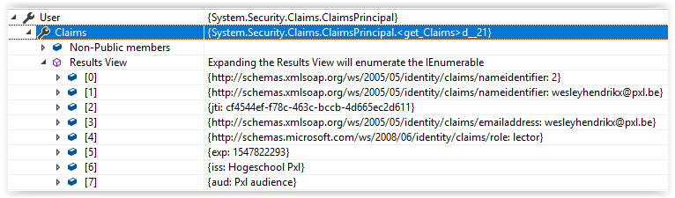
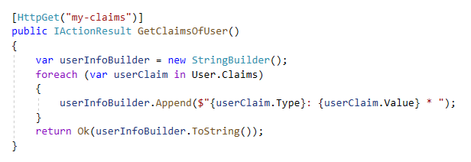
Authorization
By inspecting the claims of the authenticated user you can make authorization decisions (e.g. send a 401 if the user does not have the admin role)
Controller has a “User” property

Slide 53
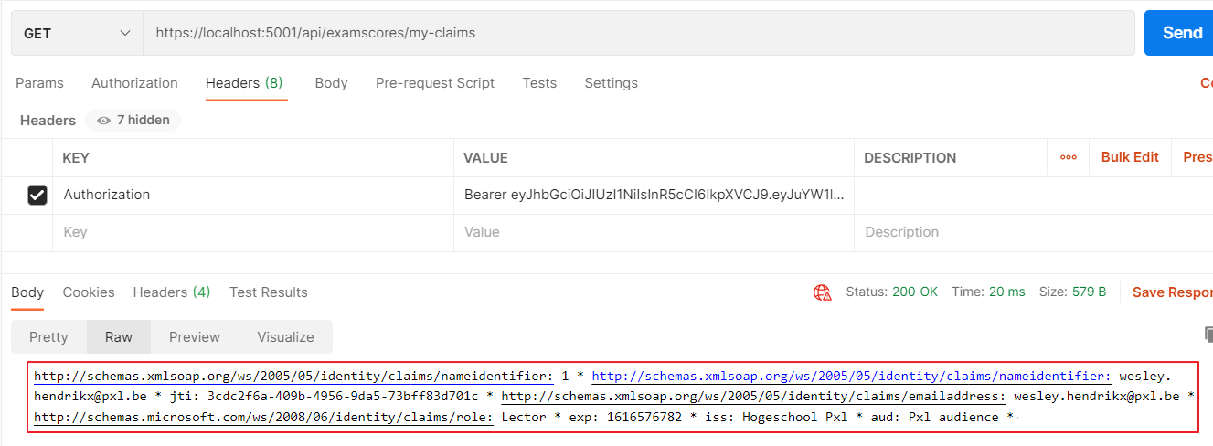
Get my claims
Get my claims with valid bearer token

Slide 54
Ohter authentication Methods
Securing a Web API

Slide 55
Other authentication methods
Out of scope for this course:
Cookie Authentication
https://docs.microsoft.com/en-us/aspnet/core/security/authentication/identity
https://docs.microsoft.com/en-us/aspnet/core/security/authentication/cookie
Windows Authentication
https://docs.microsoft.com/en-us/aspnet/core/security/authentication/windowsauth
OpenId Connect
https://app.pluralsight.com/player?course=aspdotnet-core-fundamentals&author=scott-allen&name=aspdotnet-core-fundamentals-m7&clip=2

